Slide 1
A Big City Adventure Awaits
Laura Clark, Christine Mitchell, Josh Stephens

Slide 2







Before you grab your walking shoes, cameras, and water bottle, to explore “The Big Apple” or “The City”, you will need to plan for your big city vacation adventure and we are here to help!

Slide 3
Utilizing
Tableau
for our Dashboard...

Slide 4



You will have an interactive experience where you will first be prompted to select which BIG CITY that you want to explore...
OR

Slide 5



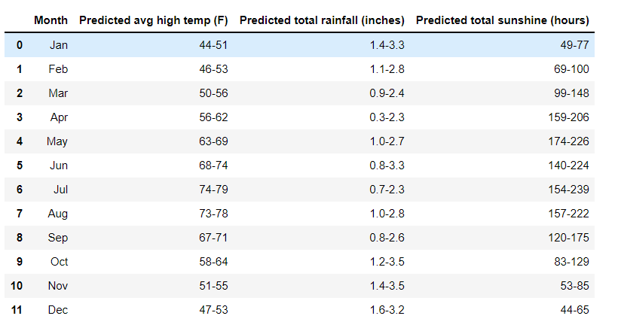
Next, you may ask yourself when should
I plan my adventure?
Considering there will be a lot of walking, our team recommends that you plan your trip when you will be the most comfortable to visit.
So, we will provide a table predicting the average maximum temperature, precipitation, snowfall (NYC), and sunlight (London) per month so you can decide the optimal time frame to book your trip!

Slide 6


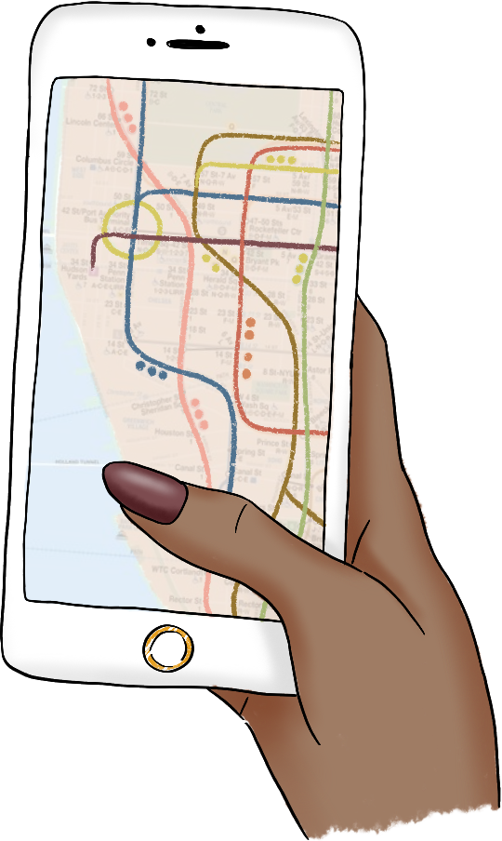

Next, where should you book your hotel?
We will provide a map of the city with a layer of hotel accommodations that include not only the location, but the price category, and the average rating.

Slide 7


Itinerary Made Easy
For those who want to make the most out of their trip,
You will have the option to add an additional layer to your city map that group nearby points of interest so that you can optimally create your daily itinerary!

Slide 8



Do you need to refuel for the day? Or want to add to your cultural culinary experience?
You will have the option to add yet another layer to our map. This time you can add nearby restaurants that will include their location, the type of restaurant, price category and average rating.

Slide 9







So, now that you have an ideal itinerary go book your trip!

Slide 10
Behind the Scenes

Slide 11

Why This Topic?
Our team was interested in creating a fun and adventurous project utilizing tools and skills that we learned throughout the course. We all enjoyed working with maps. So, we thought how fun it would be to plan a trip to select cities by creating an interactive layered map to help the user explore a big city.

Slide 12




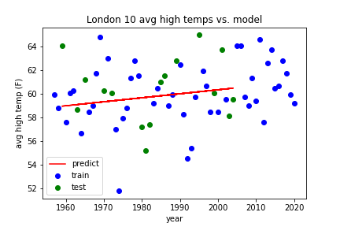

Toolkit
Yelp APIs & more
CSV Files for Tableau Datasets
Pandas/Jupyter Notebook for data exploration and test model.
PostgreSQL DB to store weather data
Machine Learning Linear Regression Model
Tableau for Interactive Dashboard and Data Visualization.

Slide 13

Data Exploration
We are utilizing a variety of different data sources for our two selected cities

Slide 14
Weather Data
London:
Source: https://www.metoffice.gov.uk/pub/data/weather/uk/climate/stationdata/heathrowdata.txt
More information: https://www.metoffice.gov.uk/research/climate/maps-and-data/historic-station-data
The dataset contains monthly weather data for Heathrow (London Airport) from January 1948 - August 2021. Each month includes details such as: Mean daily maximum temperature, Mean daily minimum temperature, Total rainfall, and Air frost days.
NYC:
Source: https://www.weather.gov/wrh/Climate?wfo=okx
Each month includes the following details: Mean daily maximum temperature, Mean daily minimum temperature, Total precipitation, and Total snowfall
Using vlookups, the data was consolidated from multiple tables and worksheets into one CSV file that mimicked the format of the London data. The dataset was loaded into a DataFrame and grouped by month. Averages and minimum and maximum values were captured.

Slide 15
Points of Interest Data
London:
It took a while to find a website with the desired data, and that was http://tour-pedia.org/about/datasets.html
Although it needed heavy editing and some geo-coordinates from an API, this had the information about the name and address.
NYC:
Data.gov was used and these were all the datasets pulled
https://catalog.data.gov/dataset/new-york-city-museums
https://catalog.data.gov/dataset/new-york-city-art-galleries
https://catalog.data.gov/dataset/new-york-city-water-trail-kayak-and-canoe-launch-sites
https://catalog.data.gov/dataset/directory-of-temporary-public-art
https://catalog.data.gov/dataset/nyc-parks-monuments
Although the format differed between most of the datasets, they all had a name, most had an address, and all had latitude and longitude in one form or another

Slide 16
Food and Lodging Data
NYC & London:
Source: https://www.yelp.com/developers/documentation/v3/business_search
Using the YELP API, extracted a data set that included the property name, type of property, rating, price, location (address & coordinates), and url. We moved from using the Kaggle Open Dataset to the API because we were limited on the data available. For example, there were only three restaurants in NYC.
The property name, address, and rating will be utilized in our layered map pop up marker. The coordinates are necessary to include them on our map.

Slide 17
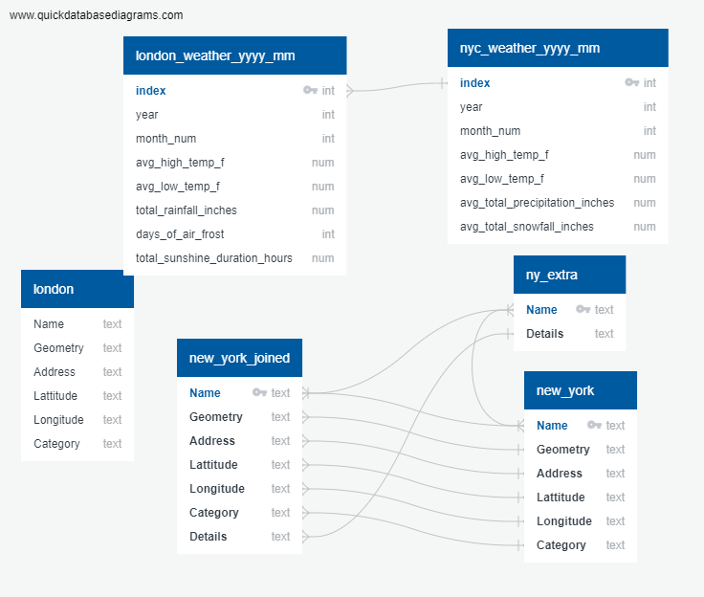

Database
Utilizing a PosrgreSQL database to house the data we are using for our Linear Regression Model to predict the weather by month.

Slide 18
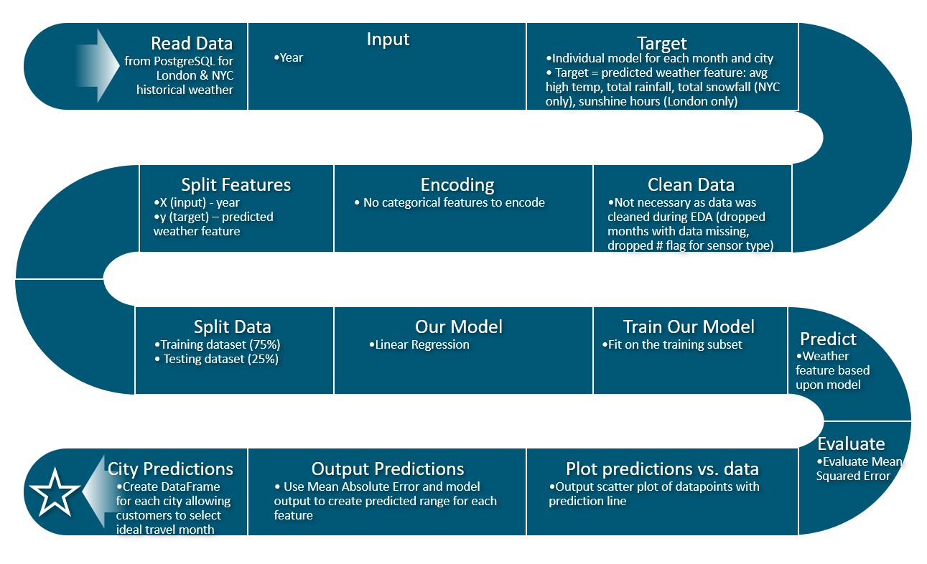
Linear Regression Model
Created separate models for each city (London and New York City), for each month of the year, and for each weather feature. The weather features that our models predict are:
average monthly high temperature
total monthly rainfall
total monthly snowfall (NYC only)
total monthly sunshine hours (London only)
We used Scikit-learn's train_test_split to separate our dataset into training sets and testing sets.
Each model is trained on 75% of the dataset and tested on the remaining 25%.
To evaluate our models, we utilized Mean Squared Error (MSE).
*Updated our Machine Learning Model from Neural Network Model to a simpler linear regression model. Upon reviewing some preliminary trends, we decided to select this model instead of our previously identified neural network model. We made this change because we felt the linear model was easier to leverage and more effectively provided the predictions we wanted for our project.

Slide 19
Model Analysis
We compared performance of these individual-month models to models that included data for all months and used month number as an input. When comparing model performance, the individual-month models generally had much better performance. For the rainfall model, however, the combined model performed slightly better. For consistency purposes, all models were broken out into individual months.
In preliminary versions of our models, graphs were created with a scatter plot for training and testing data and a line for the prediction model.
To create the predicted weather ranges for each city, we used the Mean Absolute Error (MAE) -/+ the predicted value. We then rounded the total rainfall to the nearest tenth of an inch. For other weather features, we rounded down to the nearest integer for the low end of the prediction range and up to the nearest integer for the high end of the range.
Initially we planned to show predictions for 2022 and 2023 but we found these ranges were nearly identical thus we only show one column for each weather feature. See above.

Slide 20
Team Notes for Next Steps

Slide 21
Next Steps on PowerPoint:
Get Feedback from Team
Edit Grammar
Reduce Verbiage - move some info to speaker notes
Pick a look - design, then light clip art or more sophisticated (I have neutral looking tourist, and ladies who pop for each city, and then the set I included)...a lot will depend on the final design...
Add animation
Wishlist
Challenges
Insert code clipits, sample scatter plot output from charts, and actual dashboard.

Slide 22
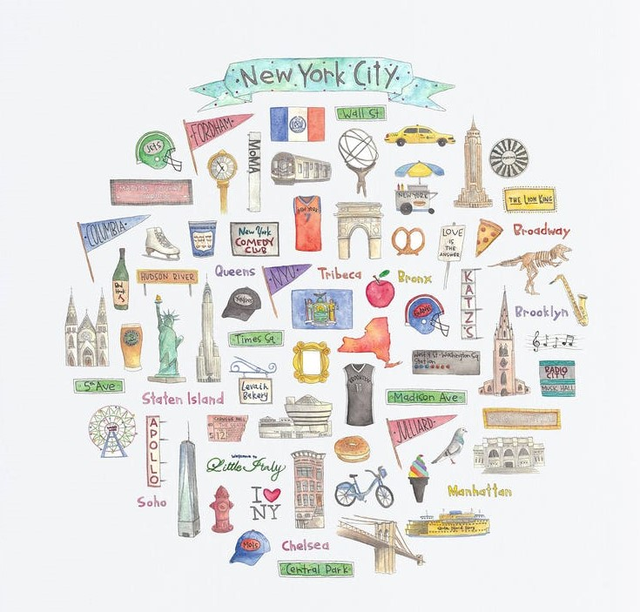
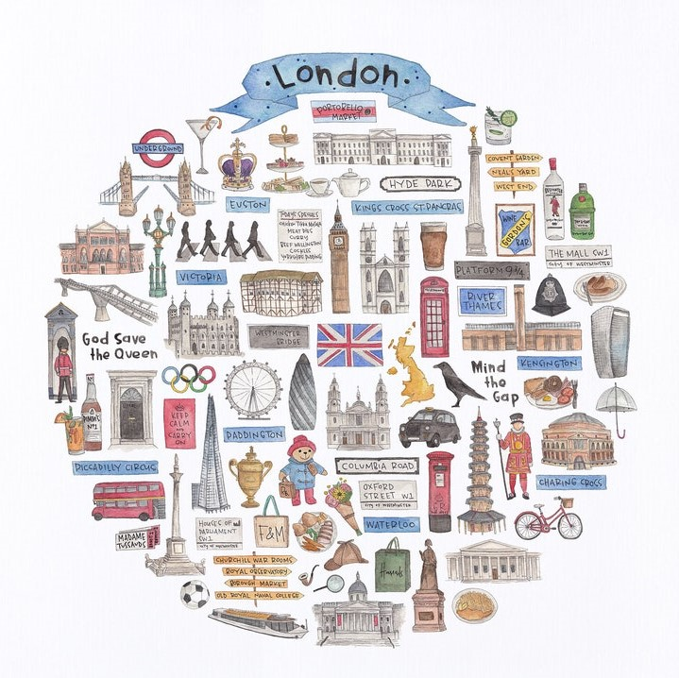
Permission approved by artist to use in presentation. Let’s see if we can use it.
www.etsy.com/listing/809496152/london-icon-watercolor-illustration

